Slide 1
State of Illinois
Web Modernization Agency Migration (Authoring UAT/Content Workflow) Feb. 14, 2022

Slide 2
Agenda
PURPOSE & OBJECTIVE
Kickoff Migration - Authoring UAT/Content Validation
AGENDA
What We have Done So Far
Review Stage Publish URL
Next Steps

Slide 3
State of Illinois Web Modernization Project
Reliable, available, and secure
Customer centric
Consistent online experience
Rapid content publishing/deployment
Accessible
Multi-language*
Improve & modernize the State’s public facing websites for the residents of Illinois by making web properties:

Slide 4
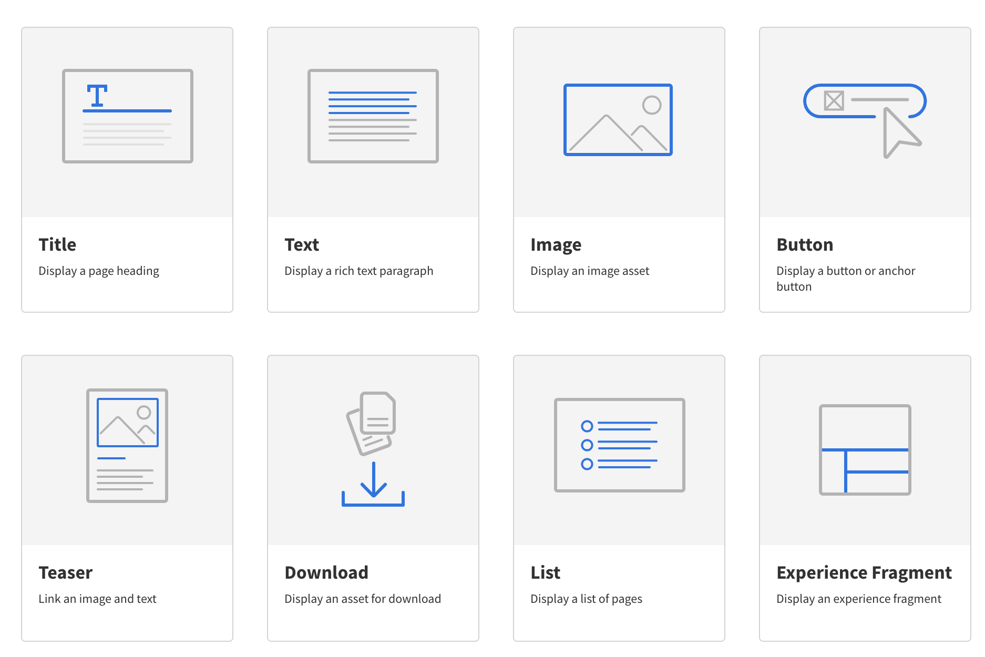
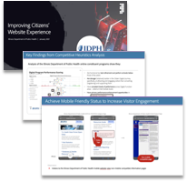
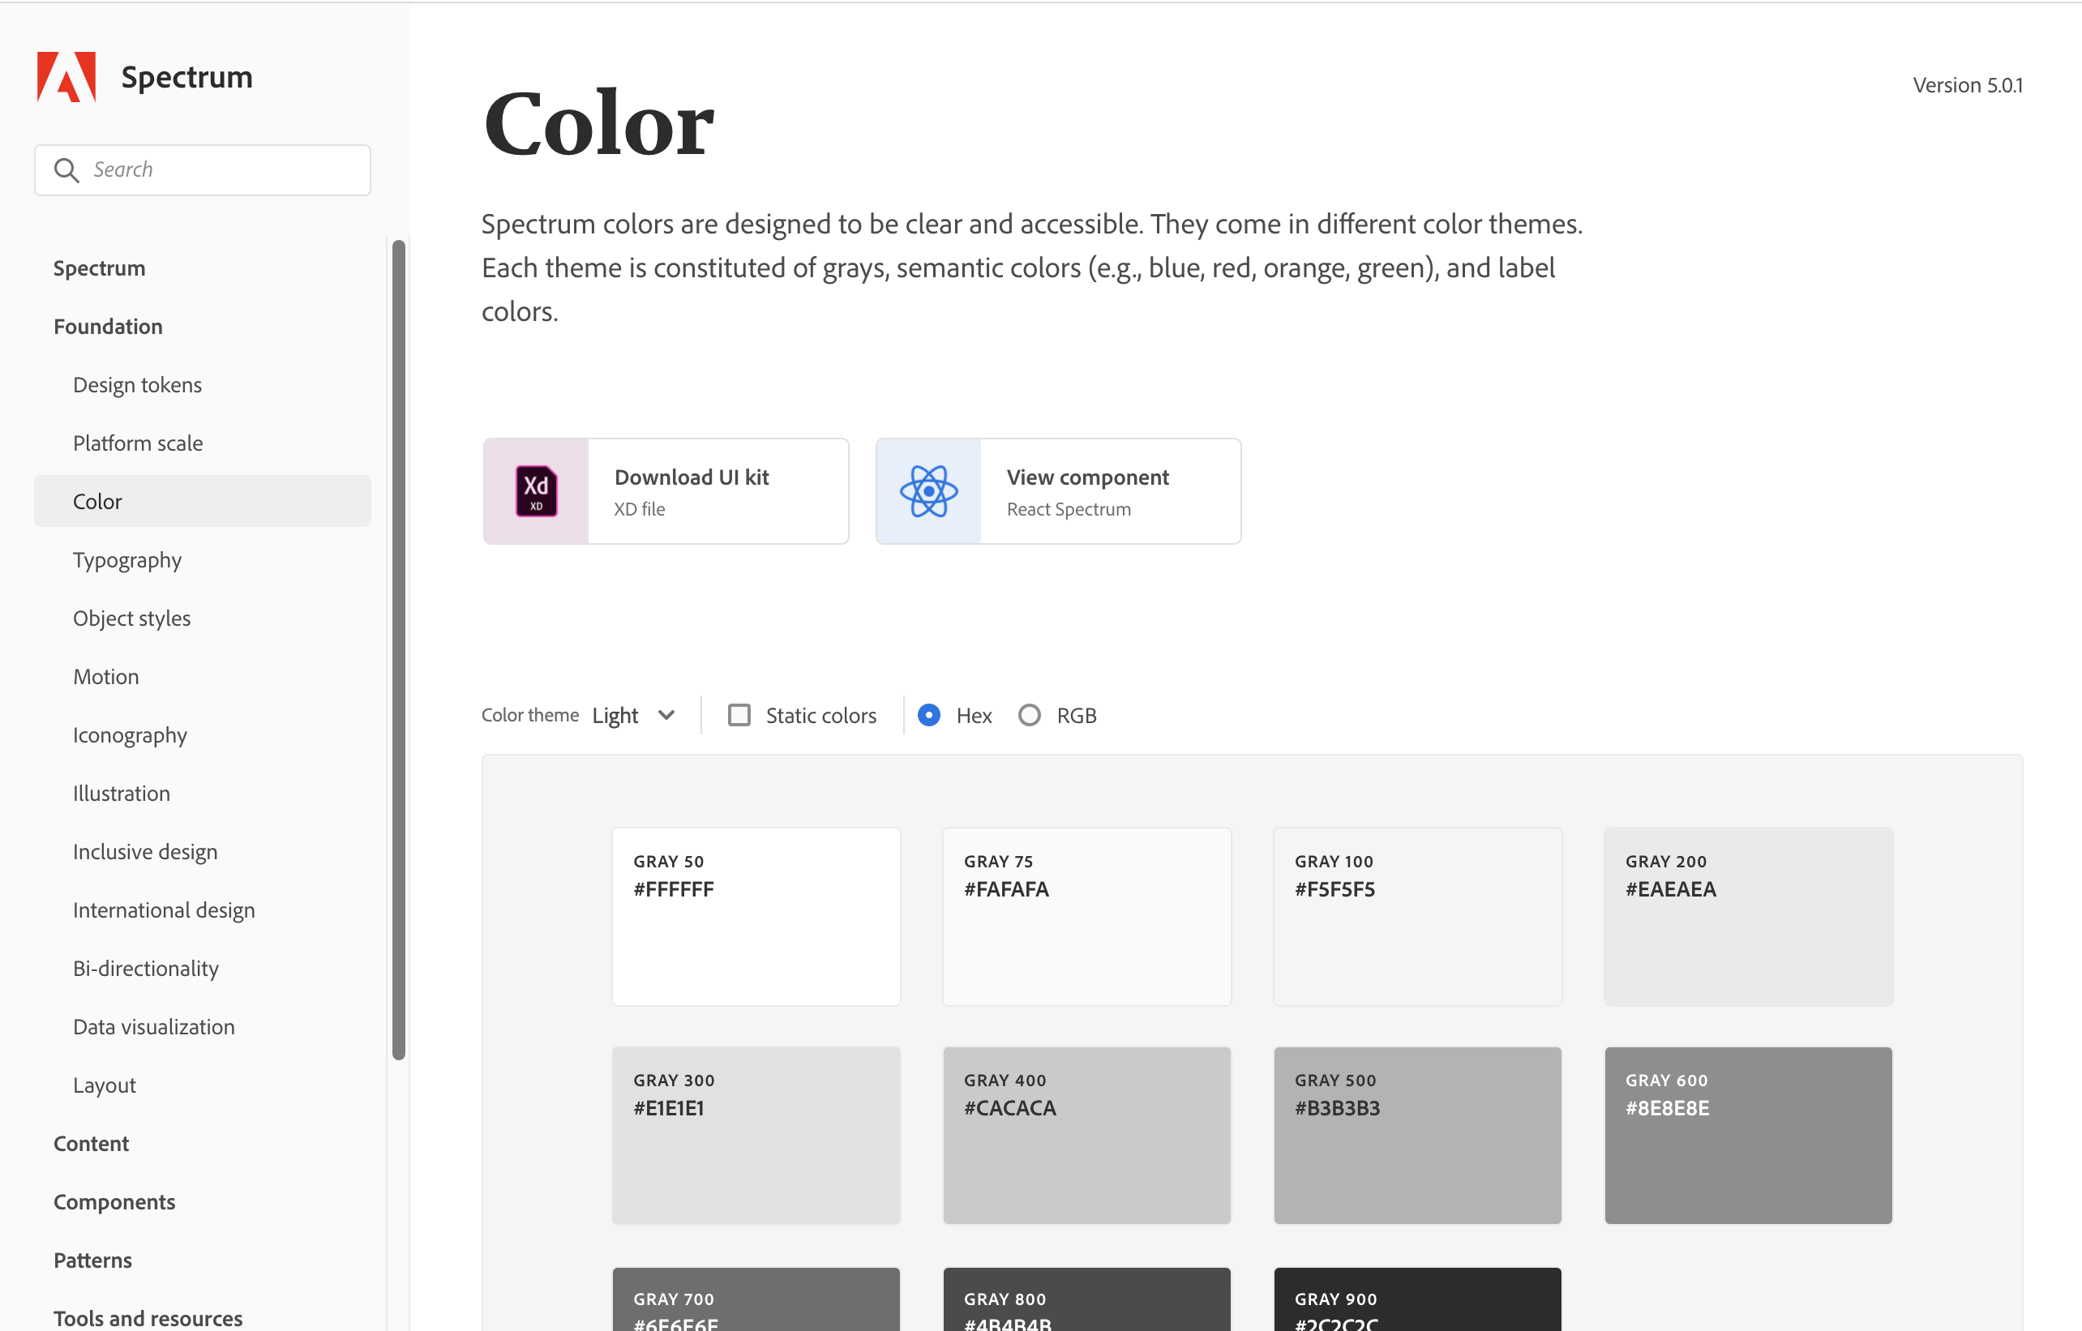
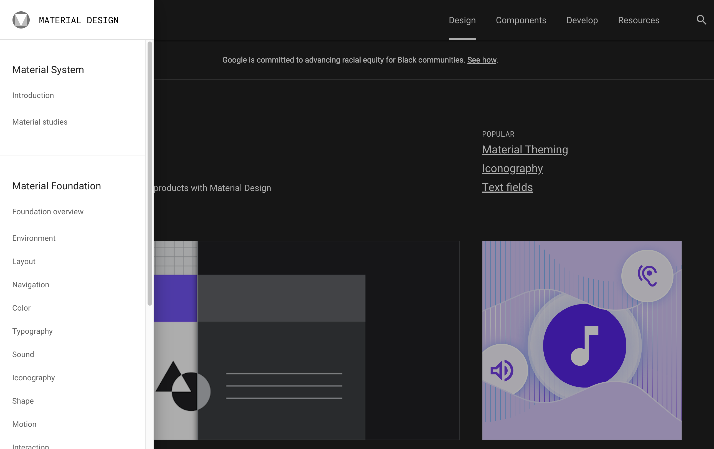
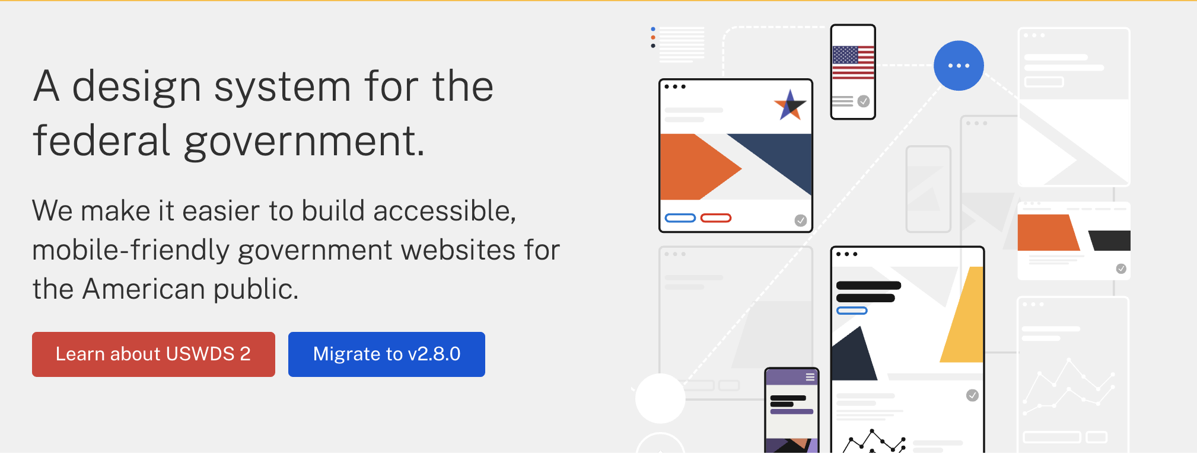
The Design Framework
OUR APPROACH
Scalable design system used to create cohesive, accessible, mobile-friendly, people focused web sites.
STEP 1
STEP 2
STEP 3
Design Framework
A Standardized Template & Component Library
An Enhanced User Experience Based On CX Discovery & Journey Mapping
Design Principles
Customer first
Inclusive
Responsive
SEO Optimized
Searchable
…
Design Foundations
Grid
Color
Typography
Spacing
Opacity
Shadow
…
Cohesive User Experience
Drastically Reduced Time To Market
Accessible, Mobile-First, Usable
CX Discovery and Journey Mapping
Improved Information Architecture
Enhanced Customer Experiences

Slide 5
The Process

Slide 6
The Migration Process
Content Mapping
Extract Content
Author Content
Review & Remediate Content
Go-Live
Information Architecture
Migration Process

Slide 7
The Migration Process
Complete
Content Mapping
Extract Content
Author Content
Review & Remediate Content
Go-Live
Information Architecture
Content Analysis
Design
Identify priority content
ROT Analysis
Redundant
Outdated
Trivial
Home page
Top landing pages
CTA pages

Slide 8
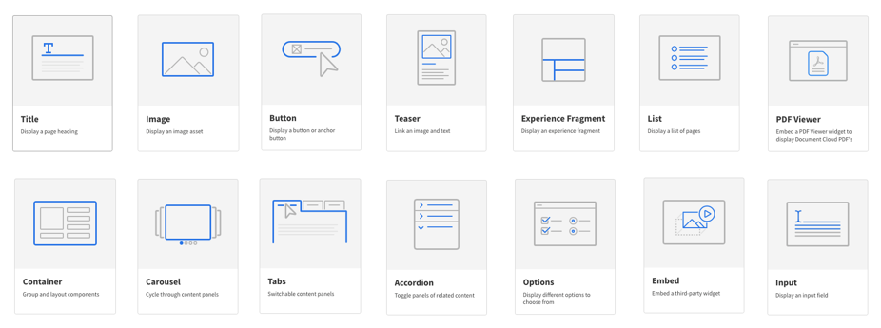
The Migration Process
Complete
Content Mapping
Extract Content
Author Content
Review & Remediate Content
Go-Live
Information Architecture
Map Content to Pages & Components
URL Mapping

Slide 9
The Migration Process
Content Mapping
Extract Content
Author Content
Review & Remediate Content
Go-Live
Information Architecture
Extract & Move Content into AEM
Author, Review, Remediate

Slide 10
The Migration Process
Content Mapping
Extract Content
Author Content
Review & Remediate Content
Go-Live
Information Architecture
Publish
URL Redirects
Go-Live

Slide 11
Stakeholder Engagement Touchpoints
Our journey with agencies from migration to Go-Live
Agency Kick-off Meeting
Stated the project goals and objectives
Introduced the Design Framework
Outlined the migration process
Promoted Adobe Training
Communicated expectations and the schedule
Content Review & Handoff Meeting
Walked through the migrated site
Reviewed what changed
Walked through the Authoring experience
Outlined action needed from the Agency
Opened communication channels: MS Teams, Trello, Office Hours
Provided enablement resources
Daily
Office Hours
Encourage agencies to participate daily
Review issues and question logged into Trello
Prioritize issues to resolve blockers before Go-Live
Coach authors on “how to” with live screenshare
Identify where additional coaching/enablement is needed
1:1 Deskside Coaching
Translated agencies web aspirations in actionable steps
Recommended ways to make agency websites even better
Provided guidance on how leverage AEM components and functionality to achieve goals
Made on the spot improvements with screenshare
Launch Agency Websites in AEM
Created a step-by-step plan for Go-Live
Ensured agencies understand their role in Go-Live activities
Agencies reviewed and approved their site launch
Provided post Go-Live support

